Slide 1


Machine Learning Hackathon
Team Name- TechGeeks
Team Leader Name- Shakti Chaturvedi
Team Leader Email Address- shaktichaturvedi33073@gmail.com
Team Members Name-
Jatin Kshatriya
Shrinath Asati
Kishan Singh

Slide 2
Brief Description of the Problem at hand: 1. The problem at hand is to build a robust model that can accurately predict whether a user belongs to the Healthcare Professional (HCP) category and determine their specialization (taxonomy) based on ad server logs. The goal is to classify users as HCPs or non-HCPs and identify their specific specialization within the healthcare domain. 2. Objective: Accurate classification of HCPs and identification of Taxonomy (specific specialization). 3. Dataset: Contains features like device type, platform information, IP addresses, geographic locations, search patterns, site URLs, and keywords. 4. Target Variable: IS_HCP - Indicates if a user is an HCP or not.

Slide 3
Solution proposed and description: 1. Data Exploration: Understand dataset structure, variable distributions, and patterns. 2. Preprocessing: Handle missing values, convert categorical variables, and perform necessary transformations. 3. Feature Engineering: Extract meaningful information, create derived variables, and enhance predictive power. 4. Model Building: Train machine learning algorithms (e.g.Random forest Classifier, logistic regression, decision trees) on labeled data. 5. Evaluation: Assess model performance using metrics like accuracy, precision or F1 score..

Slide 4
Approach: Data Visualization, Feature Selection and preprocessing: 1. Visualize data using histograms, bar charts, and scatter plots. 2. Identify insignificant columns and drop them from the dataset. 3. Handle missing values by imputation or dropping rows/columns. 4. Convert categorical variables into dummy variables using one-hot encoding. 5. Drop the main variable to avoid multicollinearity. Model Building, Training and Evaluation: 1. Utilize Random Forest for classification HCP classification and specialization prediction. 2. Ensemble method combining multiple decision trees. 3. Robust against overfitting and handles various feature types. 4. Split the dataset into training and testing sets. 5. Train the Random Forest model on the training data. 6. Evaluate the model's performance using appropriate metrics like accuracy, precision. Hyperparameter Tuning: 1. Optimize the Random Forest model by tuning hyperparameters. 2. Conduct a grid search or use other techniques to find the best combination of hyperparameters for improved performance. Model Validation and Interpretation: 1. Validate the trained model on the testing data to assess its generalization capability. 2. Interpret the results to gain insights into the importance of different features in predicting HCP category and specialization.

Slide 5
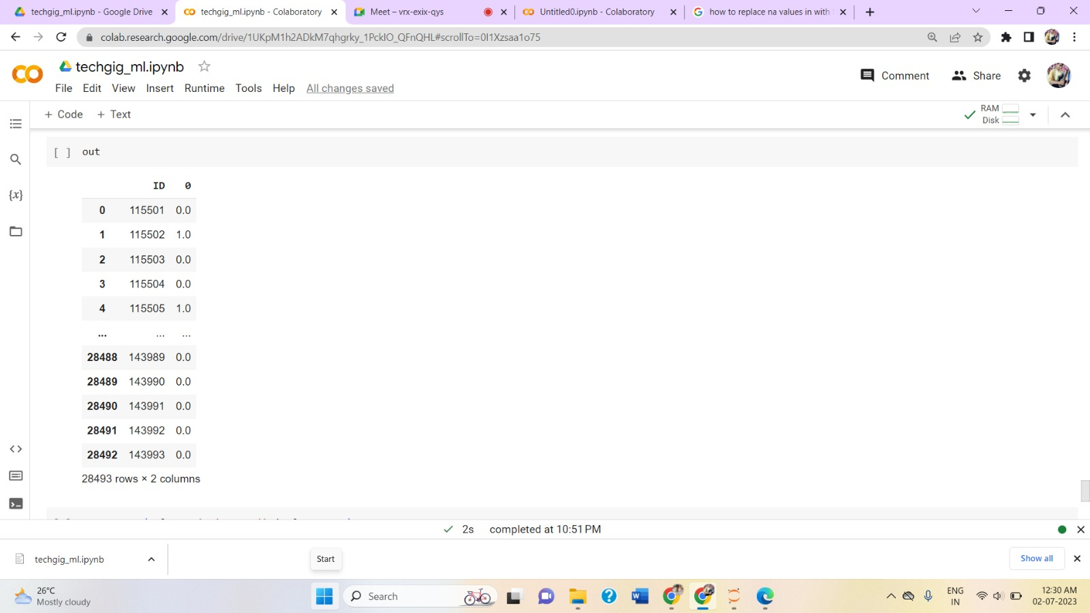
Execution Demo (Video/ Screenshots) of the solution: Predicted output:
Model Accuracy:

Slide 6
Source code in ZIP file/Github URL: Source code link: https://github.com/shakti2002/Is_HCP_DOCERE

Slide 7
THANK YOU!

